Slide 1
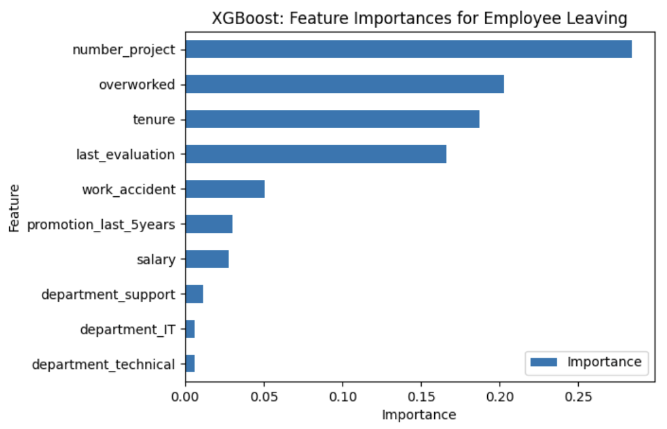
Executive Summary : HR Analytics
Salifort Motors Analytics Project to Improve Employee Retention
Project Overview
The HR Department is taking initiatives to improve employee retention at the company. The have collected data from employees and aims to answer the question:
What’s likely to make the employee leave the company?
The goal for this study is to predict whether an employee will leave or stay. This study considered a logistic regression model and three types of tree-based modeling: Decision Tree, Random Forest, and XGBoost.
Set a limit of 5 to the number of projects that the employees get assigned to
Re-evaluate project timelines and expectations
Consider hiring more people
Recalibrate the employee evaluation system to make sure the employees who contribute more or put in more effort achieve high evaluation scores
Create an Award System that will reward employees when they reach certain number of years in the company
Initiate company-wide and team-wide retrospectives and discussions to understand and address issues with company culture
Investigate why four-year tenured employees have very low satisfaction levels. Also, consider giving them incentives when they reach the four-year mark in the company
The employees were categorized as overworked when they are working for 200 hours or more on monthly, or approximately 50 hours per week on average for a whole year.
XGBoost outperformed all the models and has identified the following factors with the most impact on the employee’s decision to quit or stay.
To further improve the results of this study, it is recommended to consider other factors that might affect an employee's decision to leave such as the distance between the company and the employee's residence, their salary growth in the past years, participation in activities that encourage work-life balance, and opportunities for growth in the company.

